Slide 1
Asking the
way

Slide 2
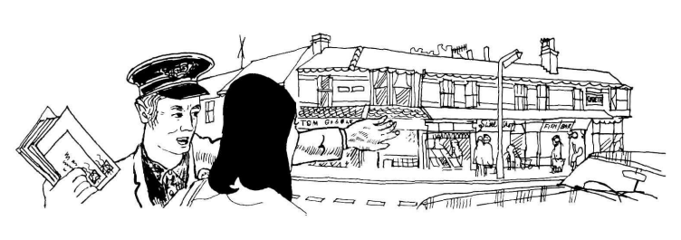
Asking the way

Slide 3
Asking the way
1st Person | Excuse me. Can you tell me where South Street is, please?
2nd Person | Take the second on the left and then ask again.
1st Person | Is it far?
2nd Person | No, it's only about five minutes' walk.
1st Person | Many thanks.
2nd Person | Not at all.

Slide 4
Asking the way
1st Person | Excuse me, please. Could you tell me the way to the station?
2nd Person | Turn round and turn left at the trafficlights.
1st Person | Will it take me long to get there?
2nd Person | No, it's no distance at all.
1st Person | Thank you.
2nd Person | That's OK.

Slide 5
Asking the way
1st Person | Excuse me, but I'm trying to find the Town Hall.
2nd Person | Take the third on the right and go straight on.
1st Person | Should I take a bus?
2nd Person | No, you can walk it in under five minutes.
1st Person | Thank you very much indeed.
2nd Person | That's quite all right.

Slide 6
Asking the way
1st Person | Excuse me, please. Could you tell me how to get to the town center?
1st Person | First right, second left. You can't miss it.
2nd Person | Is it too far to walk?
1st Person | No, it's only a couple of hundred yards.
2nd Person | Thanks very much.
1st Person | It's a pleasure.

Slide 7
Some of useful idioms
No horseplay
Rough play or pranks.
Horseplay actually has an adjective form that’s not commonly used but should be: horseplayful.
Example: No horseplay in the dining room! I don’t want anything getting broken!

